Slide 1
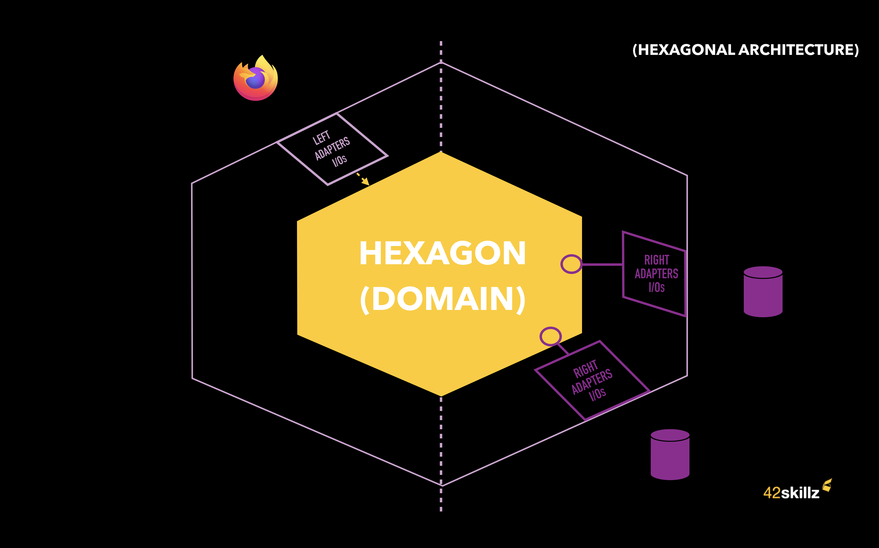
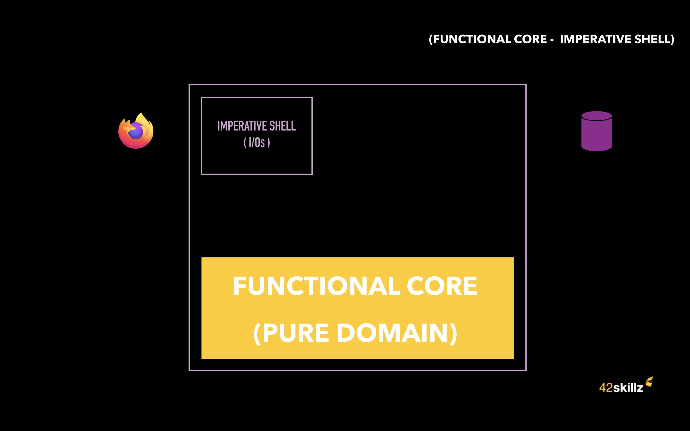
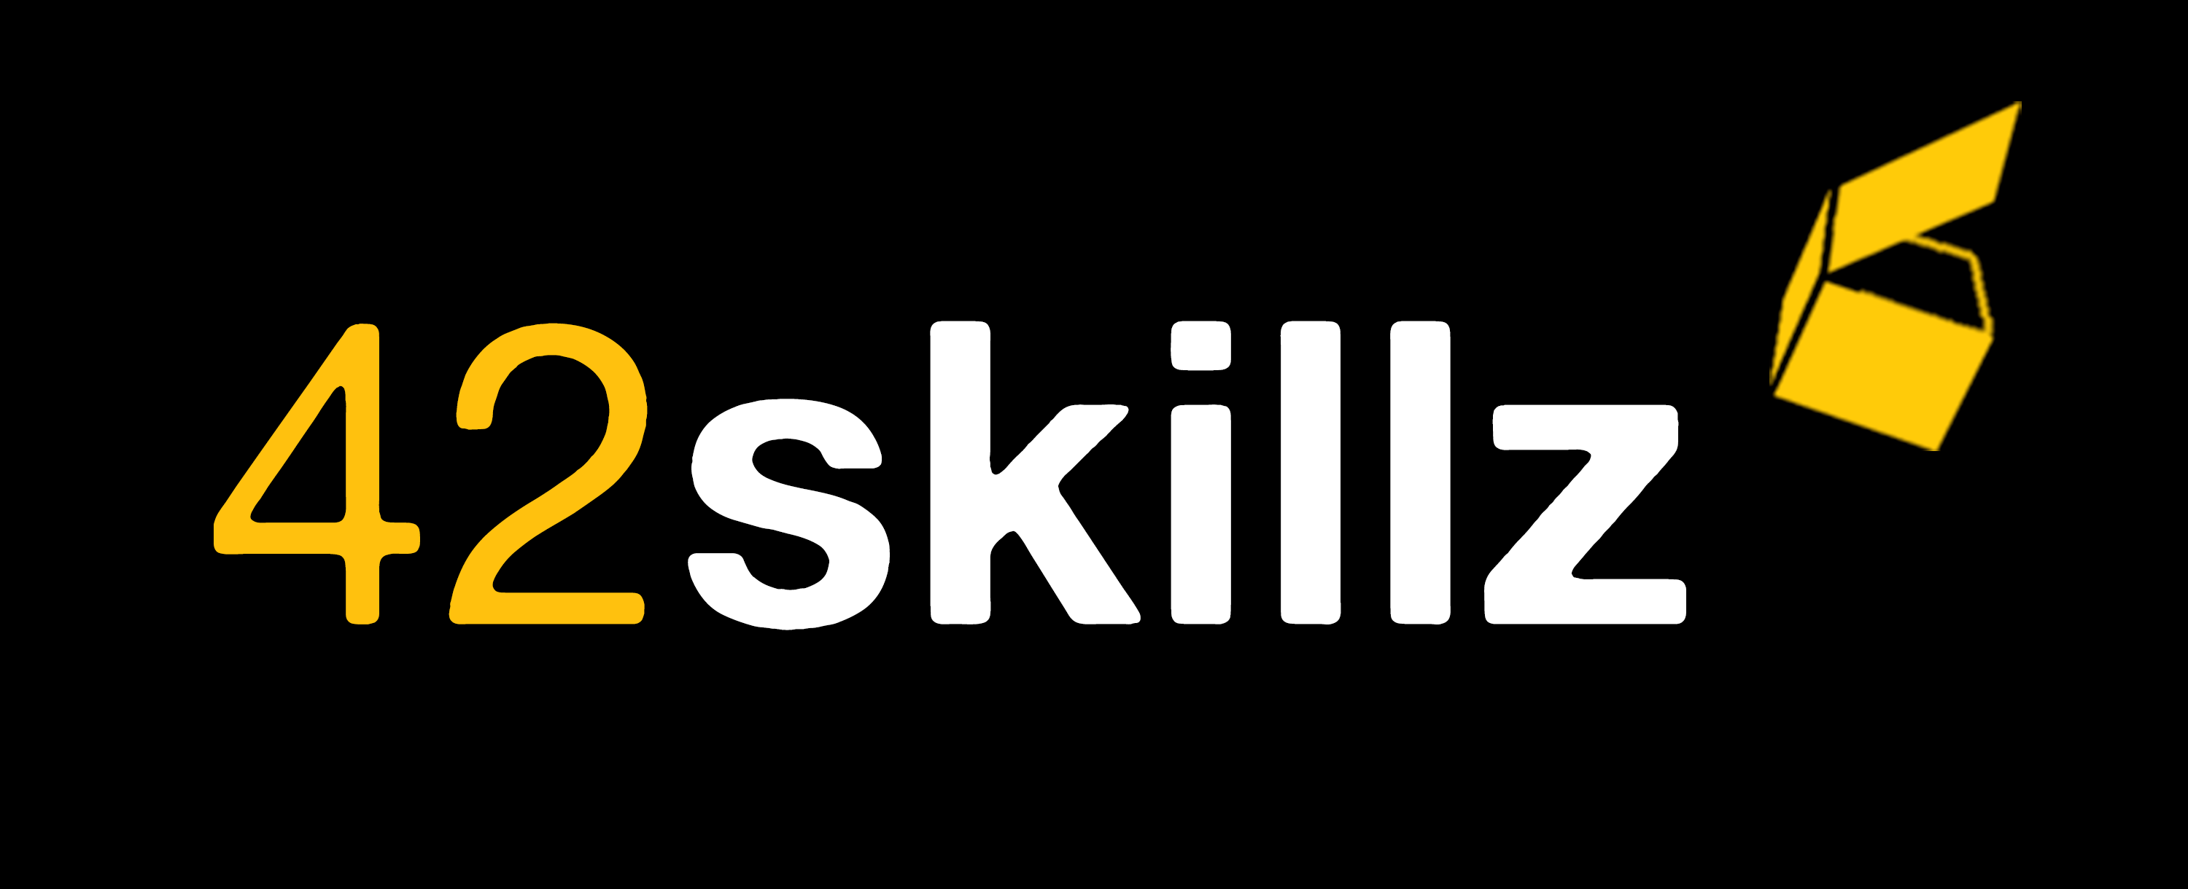
Beyond Hexagonal architecture
Hexagon (domain)
Functional core (pure domain)
Thomas PIERRAIN @tpierrain
Bruno BOUCARD @brunoboucard
Notes:
Thomas – Hello everyone! (slowly)« Beyond Hexagonal Architecture » : The idea of this talk came out one night in Paris, more than 3 years ago. It was a DDDFR meetup night and I had the chance to live-code with Alister Cockburn in order to explain what Hexagonal Architecture was and how to implement it. At the end of the event, while we were drinking beers, Jeremy Chassaing (and Clément BOUDEREAU) were asking Alistair whether or not he was aware of Function Core, Imperative shell pattern. The discussion was interesting and I was saying to my inner self: that would be another interesting talk. 3 years after we are here -with Bruno- to discuss and to compare both patterns.
Thomas - But first thing first: let’s present ourselves. My name is Thomas. I’m building software since more than 20 years now. I’m spending my time 1/ coding and creating efficient & happy dev teams (providing values with eXtreme Programming and Domain Driven Design). And 2/ doing some strategic DDD consulting, architecture and training to other customers. Aside that, I’m organizer of the DDD french meetup since 5 years now: DDDEFFARRR.
Bruno – Hello everyone, I am Bruno, and I am very glad to be here with you this evening.
I have thirty years of IT experience. I have been an agile coach for 8 years. I’m also organizer of the BDD Paris meetup since 4 years.
Bruno – Our agenda for today.
In first, a quick reminder of what hexagonal architecture is.
Then the presentation of what the functional core is.
Then we will start from a codebase in a hexagonal architecture.
Then we will transform it together into a functional core / imperative shell.
And we will finish by comparing this pattern with the hexagonal architecture
Thomas – Actually Bruno, since I was also recently involved in discussions about what is and what isn’t Hexagonal Architecture, I’d really like to end up our session with a question for them, the DDD audience.
And it might help us also, to break the ice for our final Q&A session with all of you.

Slide 2
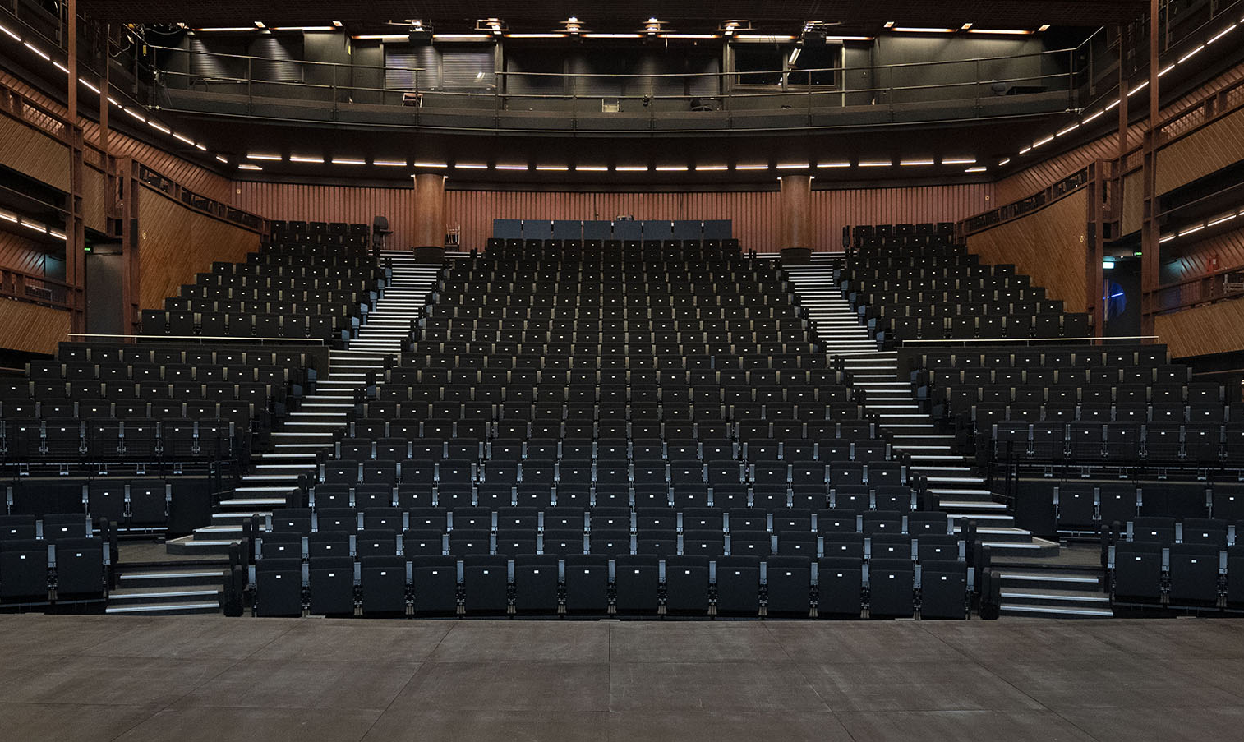
Our Domain
La Colline Théâtre National - Les Souffleurs d'Images
Notes:
Bruno - Our domain for today will be Theater.
Actually, Not the reservation, not the booking …
but the Suggestions of best possible Seats for someone that would like to attend a show with a group of people (that we call part, a party of 2, of 4, of 5, etc.)
Thomas – Something that should ring a bell to Kenny since we had created a DDD training all together using that topic.

Slide 3
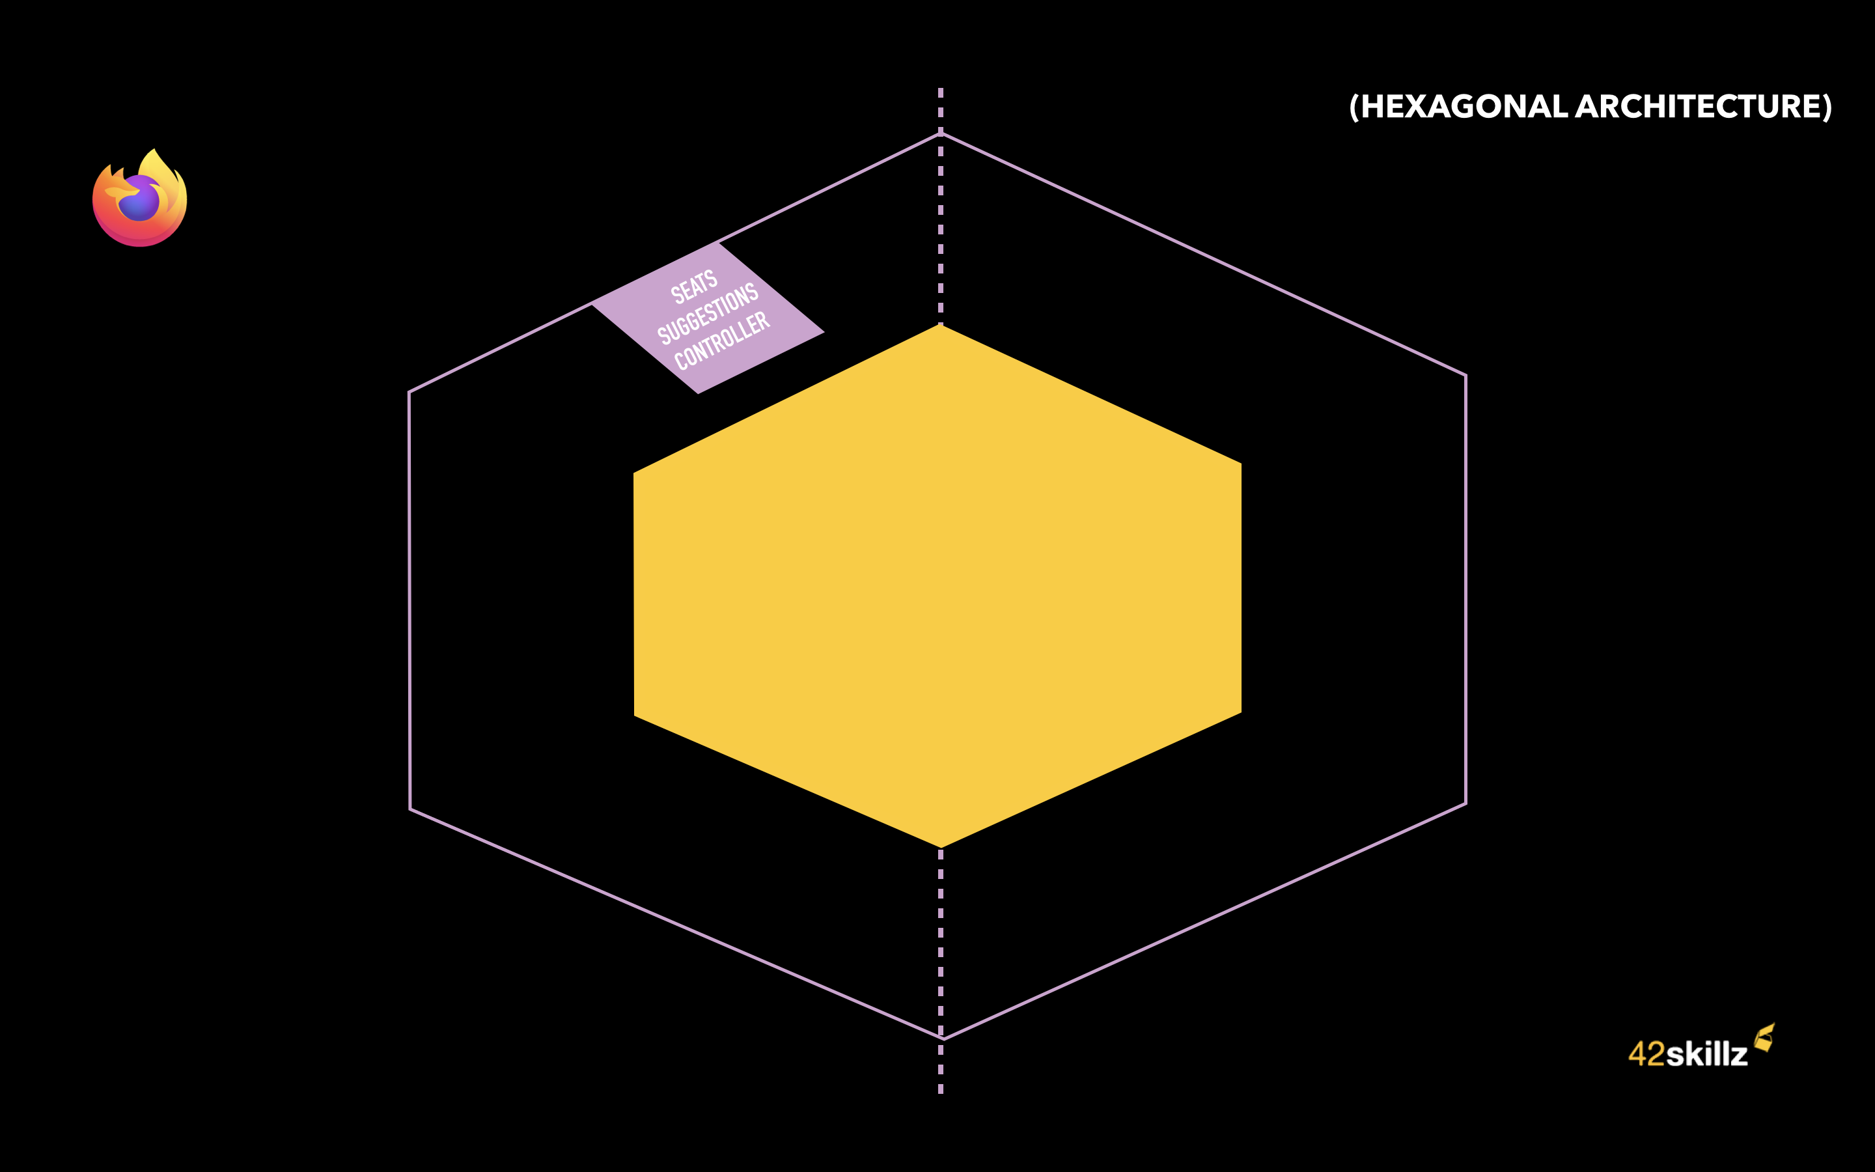
Suggesting seats in Theaters
“What seats can you suggest for 3 people wishing to attend the show Z?”
Notes:
Bruno – Ok. Let’s take an example. It all start with a request coming from a customer that is saying to our web site:
“I want to attend show Z and we are 3. What seats can you suggest to us?”

Slide 4
Suggesting seats in Theaters
“What seats can you suggest for 3 people wishing to attend the show Z?”
Seats Suggestions API
Notes:
Bruno – The request is sent to our API:
the SeatsSuggestions API in yellow

Slide 5
Suggesting seats in Theaters
“What seats can you suggest for 3 people wishing to attend the show Z?”
“I need the auditorium seating of show Z”
Auditorium Seating
API
Seats Suggestions API
Notes:
Bruno – What do we need for this job? We have to ask other backends for information, such as the show Z matching a specific auditorium seating (i.e., the theater's topology for this particular show).
Thomas - Yes, our API is making some API calls towards upstream systems handled by other teams and companies (here: the "AuditoriumSeating API").

Slide 6
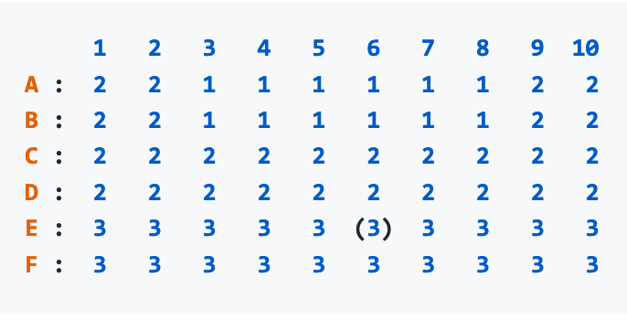
Suggesting seats in Theaters
“What seats can you suggest for 3 people wishing to attend the show Z?”
“I need the auditorium seating of show Z”
Auditorium Seating
API
Seats Suggestions API
Notes:
Bruno – When receiving our request, the Auditorium seating API is returning the auditorium topology for this show.
In other words, a list of rows, seats, corridors, pricing categories for every seat, etc.
(le prochain à parler sur le slide d’après sera Thomas)

Slide 7
Suggesting seats in Theaters
“What seats can you suggest for 3 people wishing to attend the show Z?”
“I need the auditorium seating of show Z”
Auditorium Seating
API
Seats Suggestions API
Notes:
Thomas - This external Auditorium seating API is not aware of which seats are free and which seats are already reserved.
Thomas - Our API in yellow must ask another backend: what are the available seats for this show?

Slide 8
Suggesting seats in Theaters
“What seats can you suggest for 3 people wishing to attend the show Z?”
“I need the auditorium seating of show Z”
Auditorium Seating
API
Seats Suggestions API
Seats Availability
API
“I also need to know which seats are already reserved for show Z”
Notes:
Bruno – You’re right. Hence this second call to another back-end: the “Seat availability API.”

Slide 9
Suggesting seats in Theaters
“What seats can you suggest for 3 people wishing to attend the show Z?”
“I need the auditorium seating of show Z”
Auditorium Seating
API
Seats Suggestions API
Seats Availability
API
“I also need to know which seats are already reserved for show Z”
Notes:
Bruno – Now that we have both:
The auditorium Layout and
For every seat- whether or not they are available (i.e. not reserved or reserved)
Our API in yellow can do its job.
Thomas - Which is… to find the best possible seats for this customer request.

Slide 10
Suggesting seats in Theaters
“What seats can you suggest for 3 people wishing to attend the show Z?”
“I need the auditorium seating of show Z”
Auditorium Seating
API
Seats Suggestions API
Seats Availability
API
“I also need to know which seats are already reserved for show Z”
OUR CORE DOMAIN
Notes:
Bruno – the core domain of our Seat suggestions API is really to suggest seats. We won't do the reservation, neither the booking.
Bruno- The booking part will be done afterward, with another system, by another API.
Bruno - To provide the best seats, we have rules, business rules such as:
Thomas - « do not separate parties of people; find them adjacent seats,»
Bruno - « whenever possible, try to locate them in the center of the row,»
Thomas - « try to suggest them expensive seats first » (because we have various pricing categories) etc.

Slide 11
Suggesting seats in Theaters
“What seats can you suggest for 3 people wishing to attend the show Z?”
“I need the auditorium seating of show Z”
Auditorium Seating
API
Seats Suggestions API
Seats Availability
API
“I also need to know which seats are already reserved for show Z”
Notes:
Bruno – So… We do our secret sauce to find and suggest the best possible seats for a show (here framed in yellow on the small diagram).
And then

Slide 12
Suggesting seats in Theaters
“What seats can you suggest for 3 people wishing to attend the show Z?”
“I need the auditorium seating of show Z”
Auditorium Seating
API
Seats Suggestions API
“Ok. You can have seats
A1, A2, A3 in pricing tier 1,
C4, C5, C6 in pricing tier 2
…”
Seats Availability
API
“I also need to know which seats are already reserved for show Z”
Notes:
Bruno – We return our various suggestions :
Thomas - Some are made for pricing tier 1 (the most expensive, generaly in the firts rows), some are made for pricing tier 2 (less expensive seats, etc).

Slide 13
Suggesting seats in Theaters
“What seats can you suggest for 3 people wishing to attend the show Z?”
“I need the auditorium seating of show Z”
Auditorium Seating
API
Seats Suggestions API
“Ok. You can have seats
A1, A2, A3 in pricing tier 1,
C4, C5, C6 in pricing tier 2
…”
Seats Availability
API
“I also need to know which seats are already reserved for show Z”
Notes:
Bruno –Yes. Our website will then suggest those options to the customer,
Thomas - Starting with the best and most expensive seats, of course!
Bruno – Yes Thomas, And that’s all we need to know about the domain for today.

Slide 14
API architecture (2 options)
Notes:
Thomas – Cool. Thanks for these explanations
Thomas - Tonight we will focus indeed on the architecture styles. And we will have a look at and compare 2 options

Slide 15
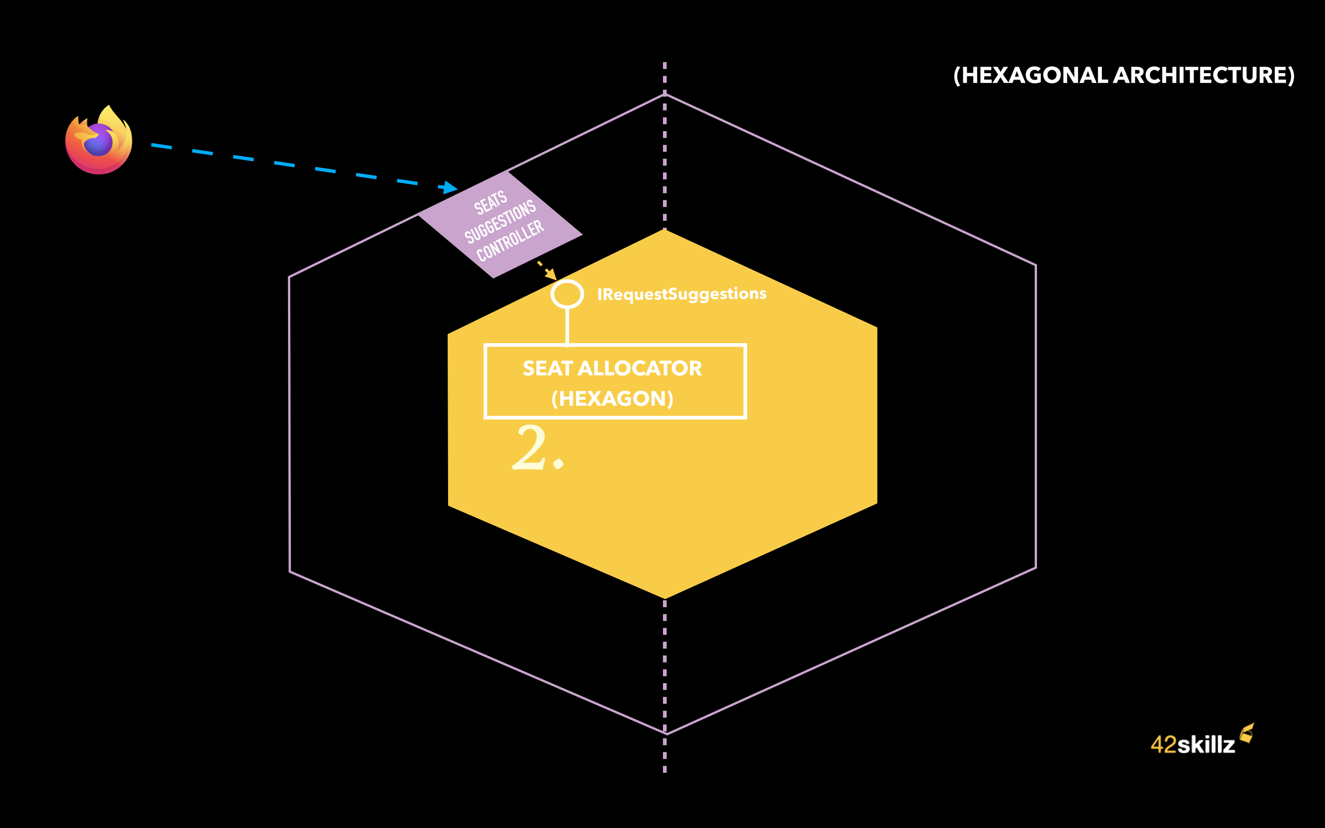
1.
Hexagon (domain)
Notes:
Thomas – First option : HEXAGONAL ARCHITECTURE.
Thomas - This one will allow us to keep our domain code (here in yellow), properly splitted and isolated from what we call the Infrastructure code (located at the border).
The infrastructure code is the one containing all the technical frameworks, I/Os, data stores and databases…
So we have:
Inside the hexagon in yellow: our Domain code
Outside the hexagon, at the borders : the infrastructure code with all the adapters
To go-in and to go-out: we are using ports (which are interfaces part of the domain) and Adapters on the infra-side, that will allow us to go in/out at runtime
This will be possible thanks to the Dependency Inversion Principle (what Gerald MEZAROS wisely called « configurable dependencies », like plugins)

Slide 16
Option 2 pre-requisite
Notes:
Bruno - Before deep dive into the second option.
We need to focus one sec on a specific thing about functional programming.
We won’t explain what Functional Programming is, but we will focus on what Pure function is.

Slide 17
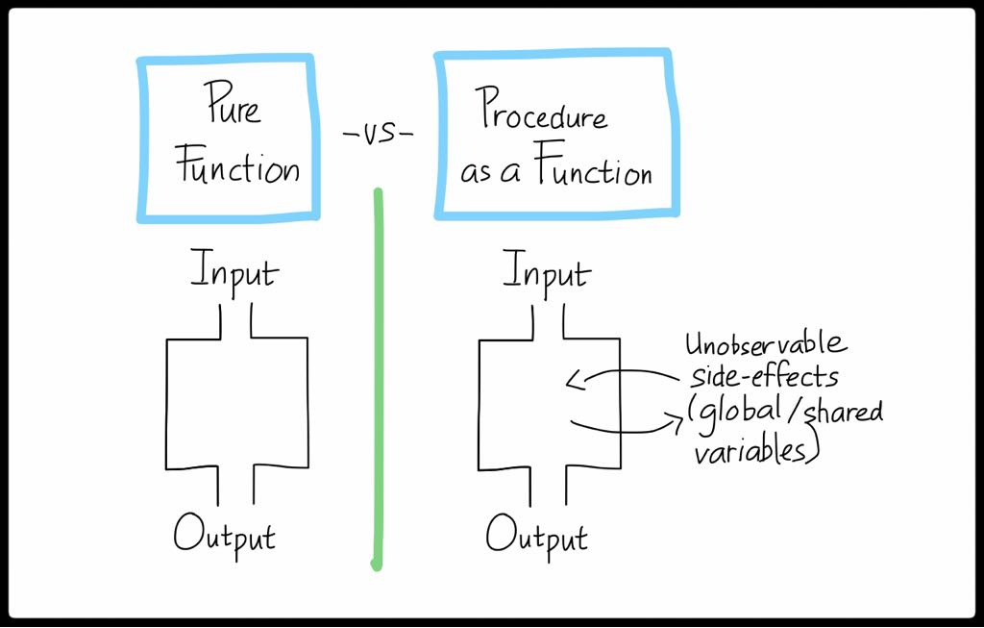
Source: http://coder.efelti.com/2018/02/introduction-of-functional-programming.html
Notes:
Bruno - A pure function is a function that will always return the same output every time you will pass it the same input.
This is possible if you don’t have any side-effects made by your function
—no change of global state, nothing.

Slide 18
Source: http://coder.efelti.com/2018/02/introduction-of-functional-programming.html
Notes:
Bruno - A procedure that looks like a function will return an output (like a function), but it will not always return the same values with the same input, because it modifies shared variables or global state.
Thomas - A procedure that looks like a function is therefore non-deterministic. And is an impure function.

Slide 19
2.
Functional core (pure domain)
Notes:
Bruno - Once this has been said, I can present you the Second option…
(petite pause)
The Functional core, Imperative shell pattern

Slide 20
2.
Functional core (pure domain)
Notes:
Bruno - In that option, we will consider two things:
1. Pure functions: located in what we call the Functional Core (here in Yellow)
2. Non-pure functions (I/Os, side effects) that will be located in what we call an imperative shell
The imperative shell is where we will chain all our function calls (either pure and non-pure functions) to support our use case.
An imperative is like a functional script, orchestrating pure and non-pure function calls.
The Yellow part (the functional core) will never do a side-effect, never call an external API, never call a database.
Pure functions of the Functional core are fed from the outside (meaning: from the shell).
Thus, the imperative shell may first fetch data towards external backends, databases, etc.

Slide 21
Hexagonal in motion
Notes:
Thomas – Ok, let’s see the differences of these 2 options in action.
Thomas - First. What happens with the Hexagonal Architecture…

Slide 22
Notes:
Thomas – Here is our hexagon in yellow. What you can see outside the hexagon but within the Infrastructure code boundaries is a left side adapter: the SeatsSuggestionsController.
Left-side adapters are kind of front doors for external users to ask questions to our component, to send queries, commands, request, etc.
Here, our main front door will be an ASP.NET web controller (because our example will be in C#).

Slide 23
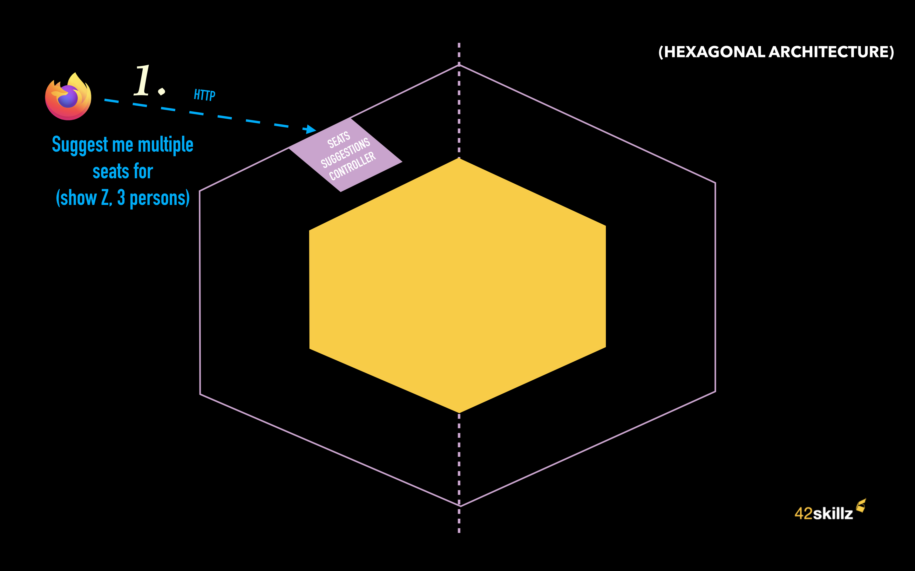
Notes:
Thomas – So. Our React web site, the front-end part will send us an HTTP GET request.
Something like: on a SeatsSuggestions resource => to query string suggestions for ShowId = Z and a party of 3 persons.
// GET api/SeatsSuggestions?showId=5&party=3

Slide 24
Notes:
Thomas – This request is handled at our WebController level, which is ALSO our left-side Adapter (here in light-purple)
This WebController/Adapter will do something every left-side adapters do:
1. Adapt from Infra data model (here JSON or HTTP querystring) to Domain types and data structure
2. Call the Domain code (the hexagon) using a left-side port method (here the left side port is the interface: IRequestSuggestions , and the method will be its MakeSuggestions() method)
3. Adapt back the answer coming from the Domain (here a SuggestionssssssMade data type) to something that will fit the corresponding infra layer : here an HTTP response (with HTTP Code, content etc)
This is the overall process. But let’s zoom into the various steps now.
The WebController will call the MakeSuggestions() method of the Hexagon (And the name of the Hexagon is SeatAllocator)

Slide 25
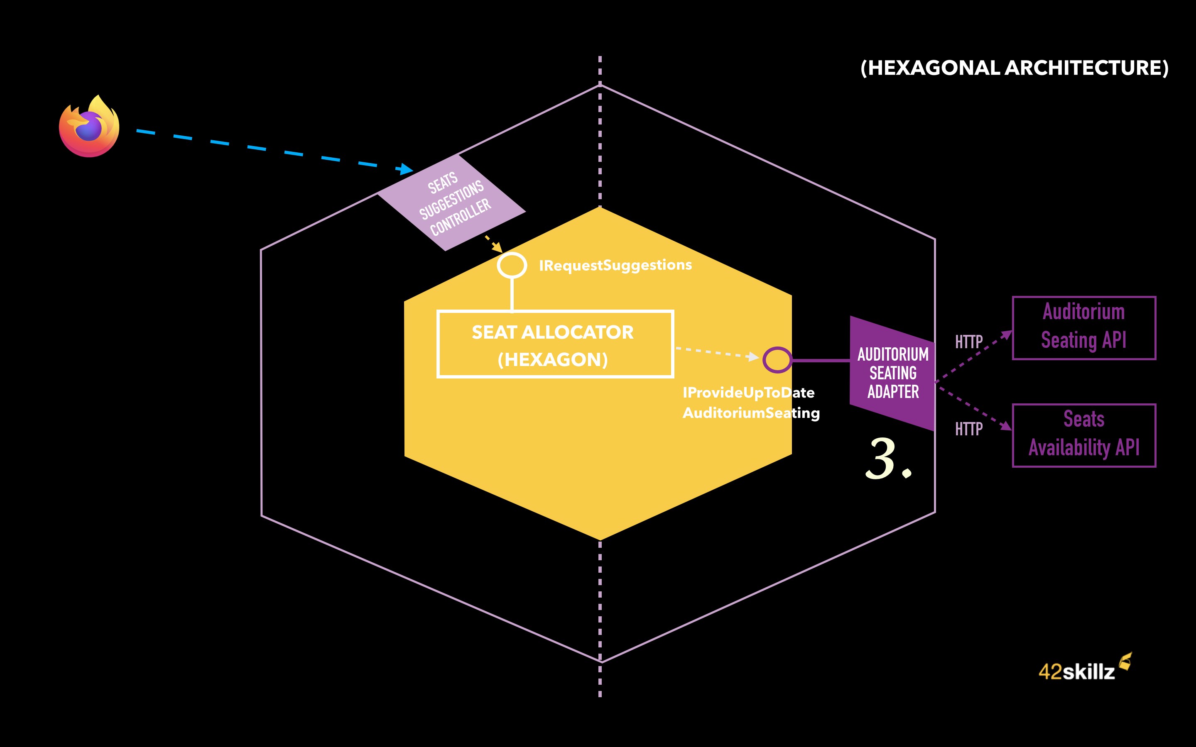
Notes:
Thomas – In order to suggest the best Seats, the SeatAllocator has to work with an AuditoriumSeating.
In other word:
the Theater topology for this show
The list seats that are already reserved for this show
Before being able to work with, our hexagon -the SeatAllocator- will first ask some information to the outside world (here 2 external APIs on the right : Auditorium Seating API & Seats Availability API).

Slide 26
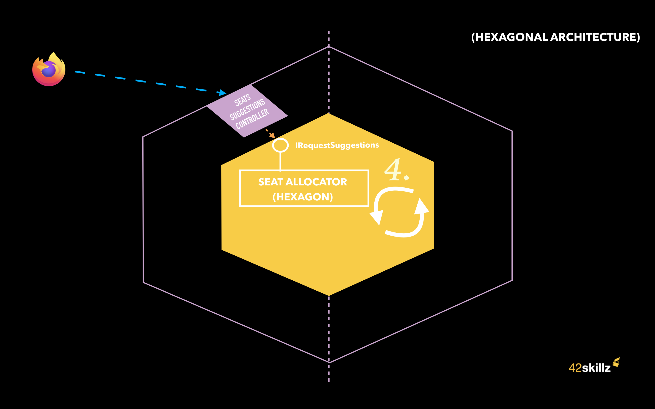
Notes:
Then the hexagon can do its own job which is to find and suggest the best possible combination of seats for this show and this number of people.

Slide 27
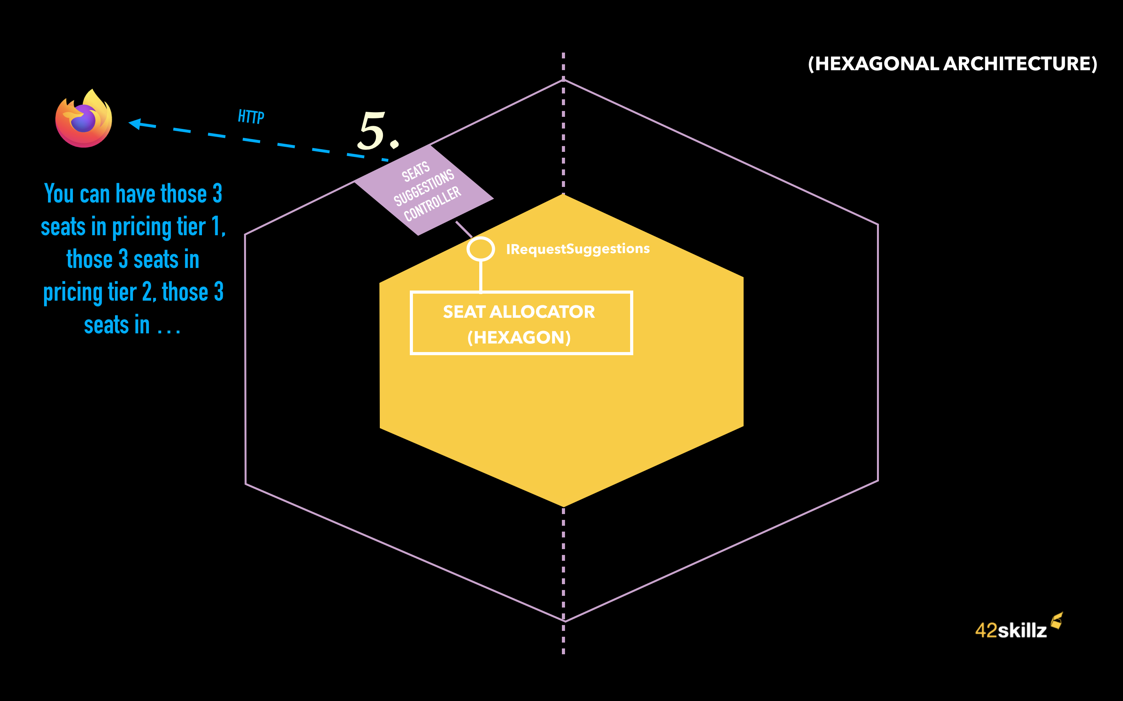
Notes:
And finally, returning the result which is something like : “you can have those 3 seats in pricing tier 1, those 3 other seats in pricing tier 2 etc.

Slide 28

Notes:
Thomas – Let’s sum-up:
A request is coming from the web site on the left, handled by a web controller which is our left side adapter here.
This left side adapter is calling the hexagon through a IRequestSuggestions port belonging to our domain and implemented by the Seat Allocator type.
The SeatAllocator type from our domain will need first to get an up-to-date AuditoriumSeating. It will ask it through a right-side port named IProvideUpToDateAuditoriumSeating (implemented by a right-side port in purple: the AuditoriumSeatingAdapter). This one will fetch Auditorium Layout in one hand and the list of already reserved seats in the other hand in order to merge them into what we call an up-to-date AuditoriumSeating (meaning: for every seat, you know if it’s already reserved or not)
Then our business logic can work and will do the job of finding best seats
Our left-side adapter will get the answer from our SeatAllocator, Adapt it to an HTTP response, and forward it to our client

Slide 29
Anti Corruption Layer (ACL)
Notes:
IMPORTANT: in our case we’ve decided to have only one right-side Adapter, acting like an Anti-Corruption Layer (ACL).
We’ve picked that option because we do not want our Domain code making the suggestions to be impacted by organizational changes from the outside. The fact that we need first, to get an Auditorium Layout and then to combine it with the list of already reserved seats got elsewhere is an implementation detail, an organizational detail that has nothing to do with the very specific domain of finding the bests seats in an auditorium seating.
Worst : it’s an implementation details imposed by external organizations & partners. Hence, the need for an ACL here, as suggested by DDD.
And in our case, we implement this ACL at the AuditoriumSeatingAdapter level. But that’s just one option. Another one may be to create and put this code into a dedicated APIs (if many people need this merging/adaptation service. An UpToDateAuditoriumSeating API for instance)
But In our case we are the only one interested in that adaptation. Hence we have decided to put this ACL at the Adapter-level. Thus to have only 1 right-side port / adapter.
Domain Driven Design helped us here to protect our domain code from other Bounded contexts external domain models and breaking changes.
This trade-off is important because this is not an orthodox implementation of Alistair’s Hexagonal Architecture (which focus on the technological aspect of things, not on the various domains and contexts like we do in DDD)
In an orthodox version of Alistair view, one should have used 2 right-side adapters instead. But this is where I disagree. And we will see that afterwards, at the end of our session.

Slide 30
Functional core, imperative shell in motion
Notes:
Thomas – That’s it for me Bruno. Now. Can you illustrate us the dynamic involved with Functional Core and Imperative Shell?

Slide 31
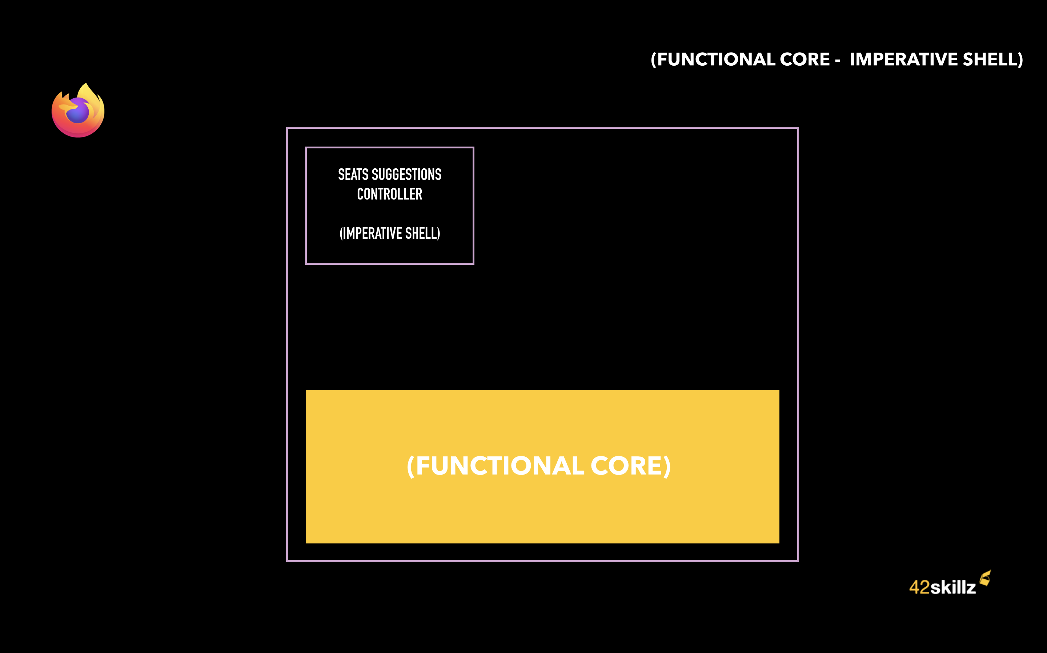
Functional core (pure domain)
Notes:
Bruno – Yes, Thomas. Let’s see that together!

Slide 32
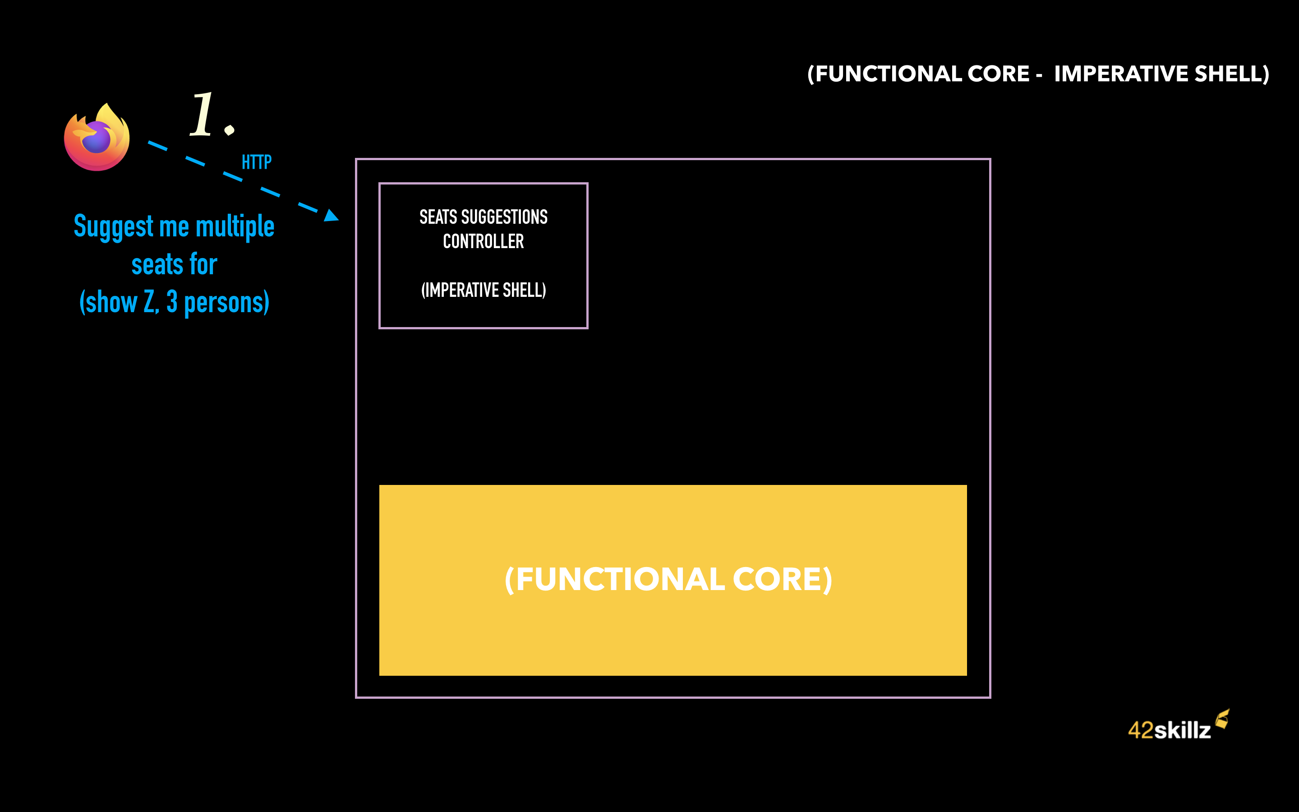
Functional core (pure domain)
Notes:
Bruno - Let’s imagine the very same request coming from our web site:
- an HTTP GET query asking for Seat Suggestions.

Slide 33
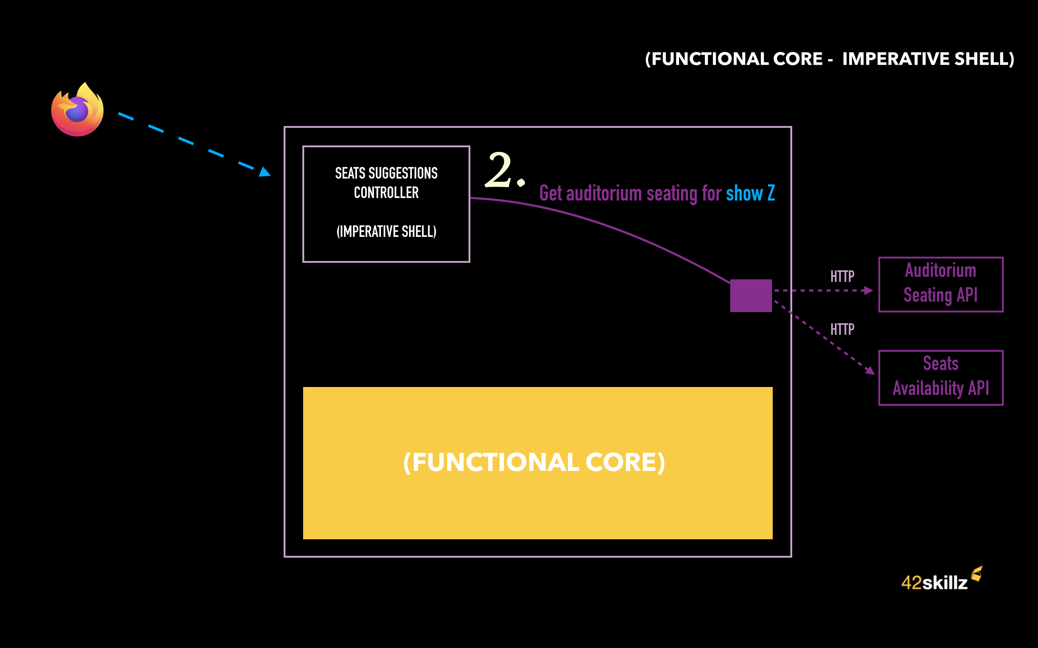
Functional core (pure domain)
Notes:
Bruno - As your previous example, it’s at the Web controller level that the HTTP request will be handled.
This one will act as the Imperative shell for our seat suggestions use case.
But contrary to your hexagonal architecture situation, our Imperative Shell, will first fetch all the data needed by the MakeSuggestions() pure function of our Functional Core.

Slide 34
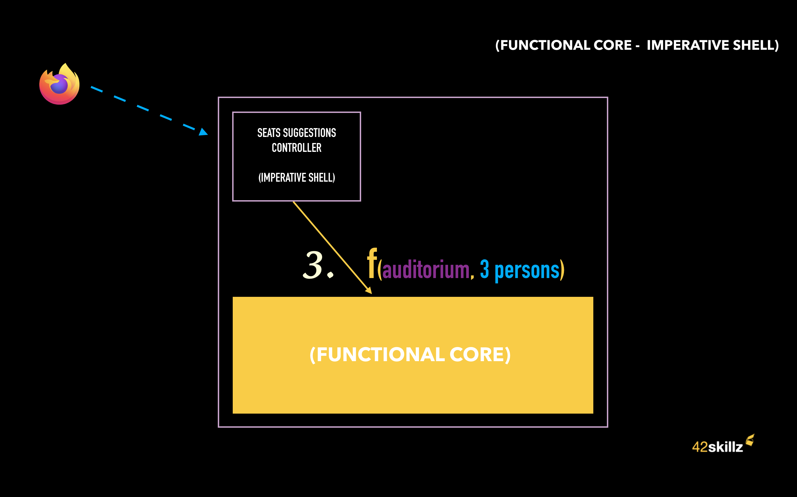
Functional core (pure domain)
Notes:
Bruno – Once our imperative shell has everything to call the MakeSuggestions() pure function, it will call it as parameters
– 3 persons
– and the up-to-date AuditoriumSeating corresponding to show Z.
The MakeSuggestions() pure function of the functional core will do the job and return a SuggestionssssssMade to the imperative shell.

Slide 35
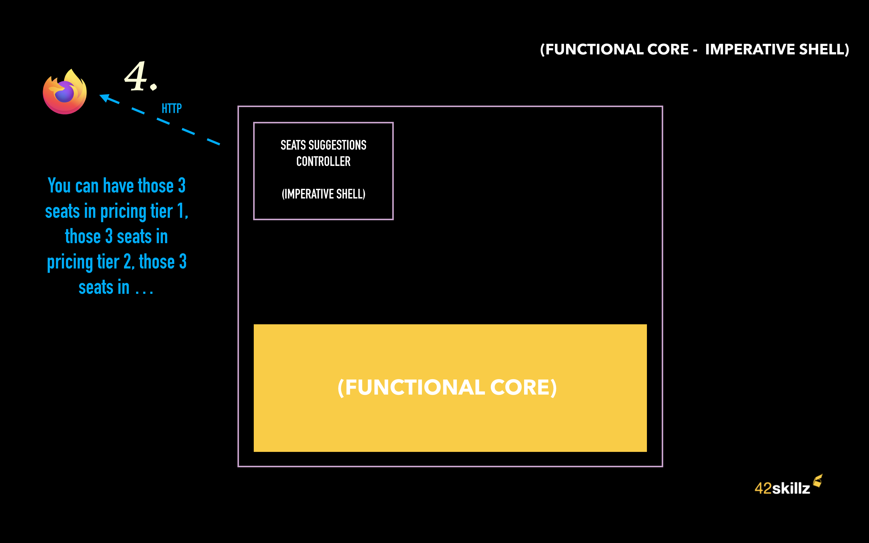
Functional core (pure domain)
Notes:
Bruno – Then, the web controller will adapt this result to an HTTP response and send it to the client.

Slide 36
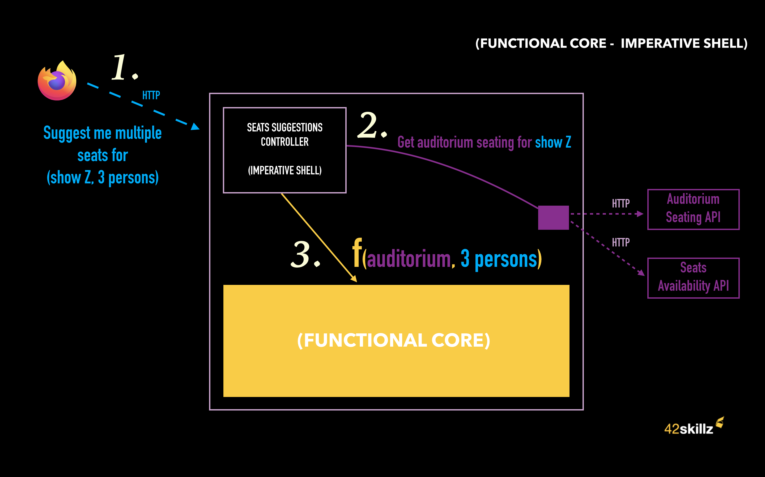
Functional core (pure domain)
Notes:
Bruno – So. To sum-up:
The HTTP Request is received by our web controller
The corresponding request handlers of the web controller will be our Imperative Shell. It will first do some side-effects by calling non-pure functions asking for Up-to-date AuditoriumSeating
The Imperative Shell will then call a pure function belonging to our functional core: the MakeSuggestions() function. This pure function won’t do any side-effect. Only pure functional domain logic in order to make seat suggestion
And finally, the Imperative shell will return the result as an HTTP response that will be sent back to the original caller (the web site).

Slide 37
From Hexagonal to functional core (live coding)
Notes:
Thomas – Ok. We talked a lot so far. Let’s show some code would you?
And here, we will migrate an hexagonal architecture API into a Functional Core, Imperative shell style.

Slide 38
(live coding)

Slide 39
More functional?
Notes:
Thomas – You wanted to show us more functional stuffs Bruno?
Bruno - Yes Thomas, I think we can go further with functional programming.
Mark Seemann has produced a blog post that goes in this direction …
Hey Thomas, can you push me the code and give me some time to sync.

Slide 40
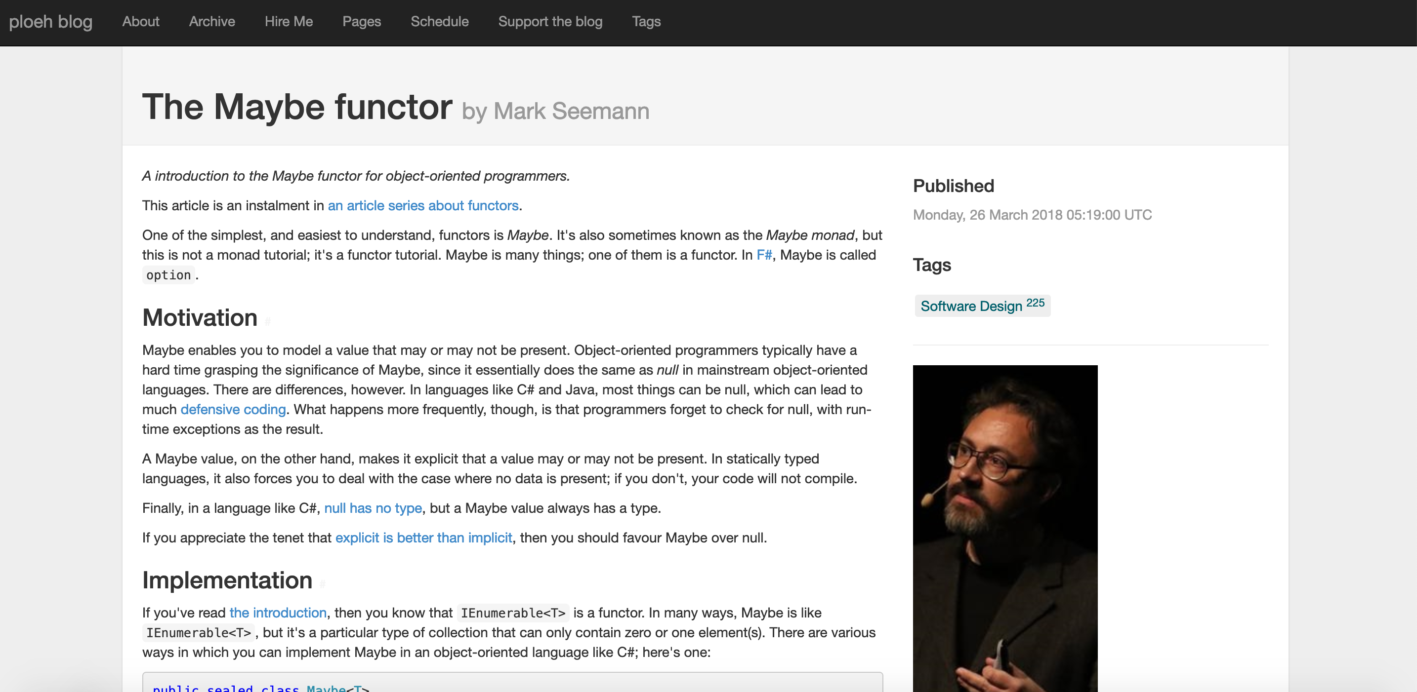
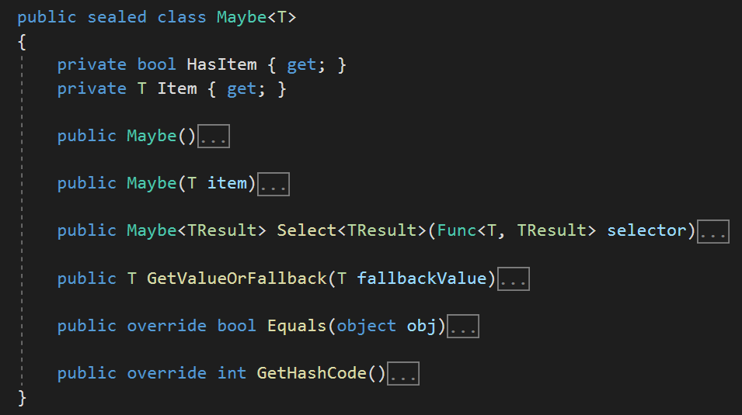
https://blog.ploeh.dk/2018/03/26/the-maybe-functor/
Notes:
Bruno - The motivation of the Maybe functor is to bring a functional taste to the object-oriented world.
Why do that?
In languages like Java, C# …, the reference types can be null, leading to a lot of defensive coding.
But the reality is that programmers sometimes forget to check for a null value, with runtime exceptions as a result.
The Maybe class allows to contain a value or not.
If the Maybe class is instantiated with a value:
public Maybe(T item)
This value may be projected through a lambda function.
public Maybe<TResult> Select<TResult>(Func<T, TResult> selector)
then this value can be returned
public T GetValueOrFallback(T fallbackValue)
The fallbackValue is needed when Maybe has to be instantiated without value, it could mean that some processing has failed.
Further, the Maybe class is a functor, so it allows you to generate functional chains just like functional languages would.
Once the Maybe class is instantiated, it is no longer possible to corrupt its integrity. If Maybe contains a value, then this value can be enriched, but it will keep its original structure.
See examples in the blog post: The Maybe functor (ploeh.dk)

Slide 41
Maybe/option illustrated
(live code)
Notes:
Thomas – Let’s do that in our code would you?

Slide 42
(live code)
Notes:
(End of live code)

Slide 43
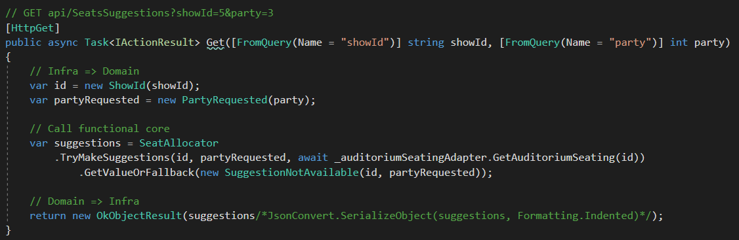
Functional Core – Theater
Makes decisions
Imperative Shell acts upon these decisions
Notes:
Bruno - It is essential to understand that it is the pure functions that make the business decisions, but it is the imperative shell that acts on these decisions.

Slide 44
How to cope with multiple I/O in sequence?
Notes:
Bruno - For educational reasons, we have chosen a simple example where the number of I/O was low.
How can we represent a sequence of functions?

Slide 45
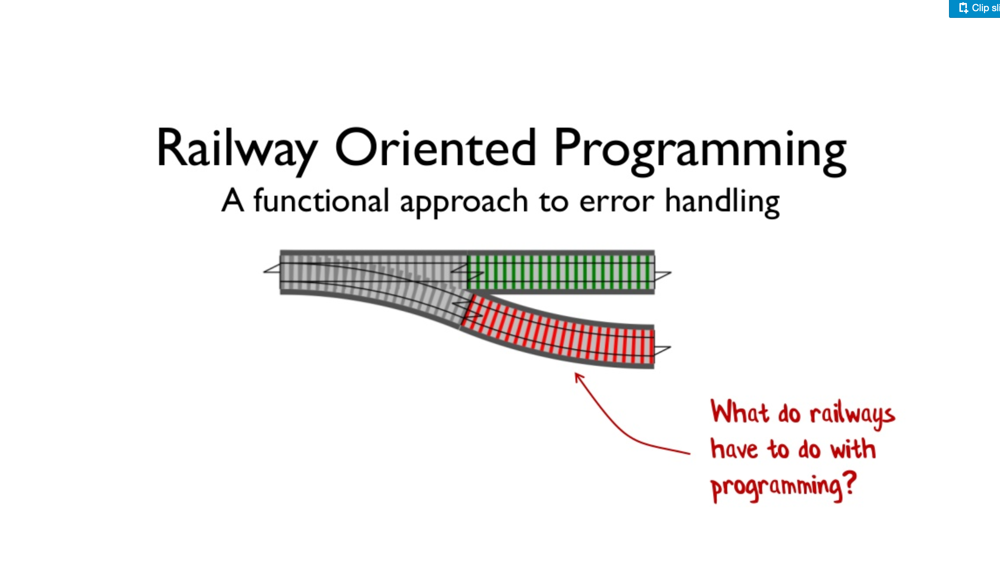
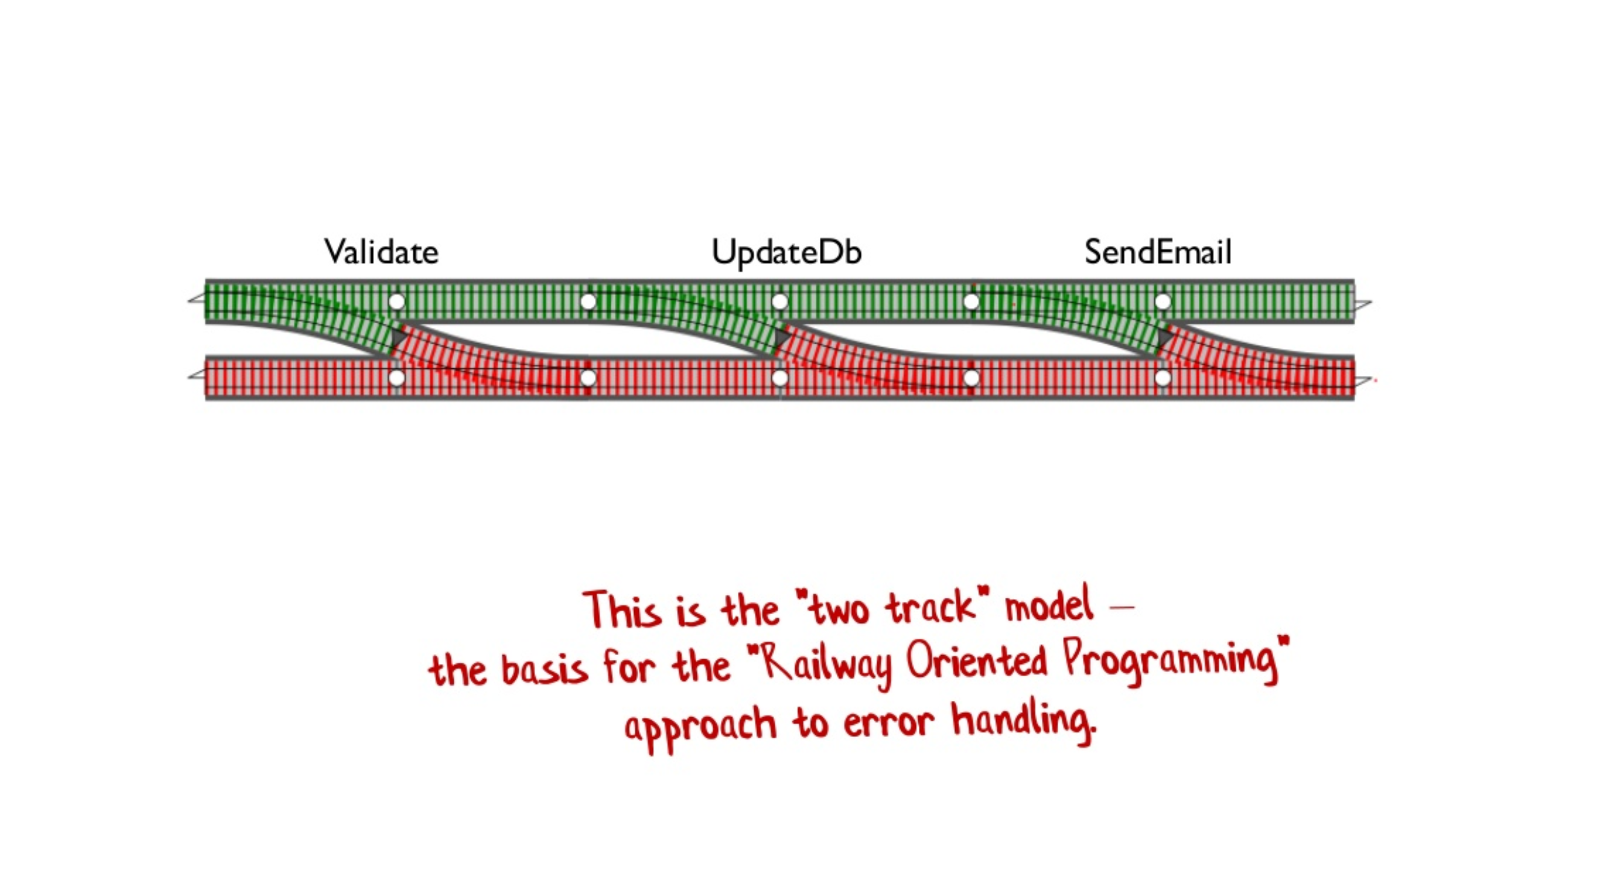
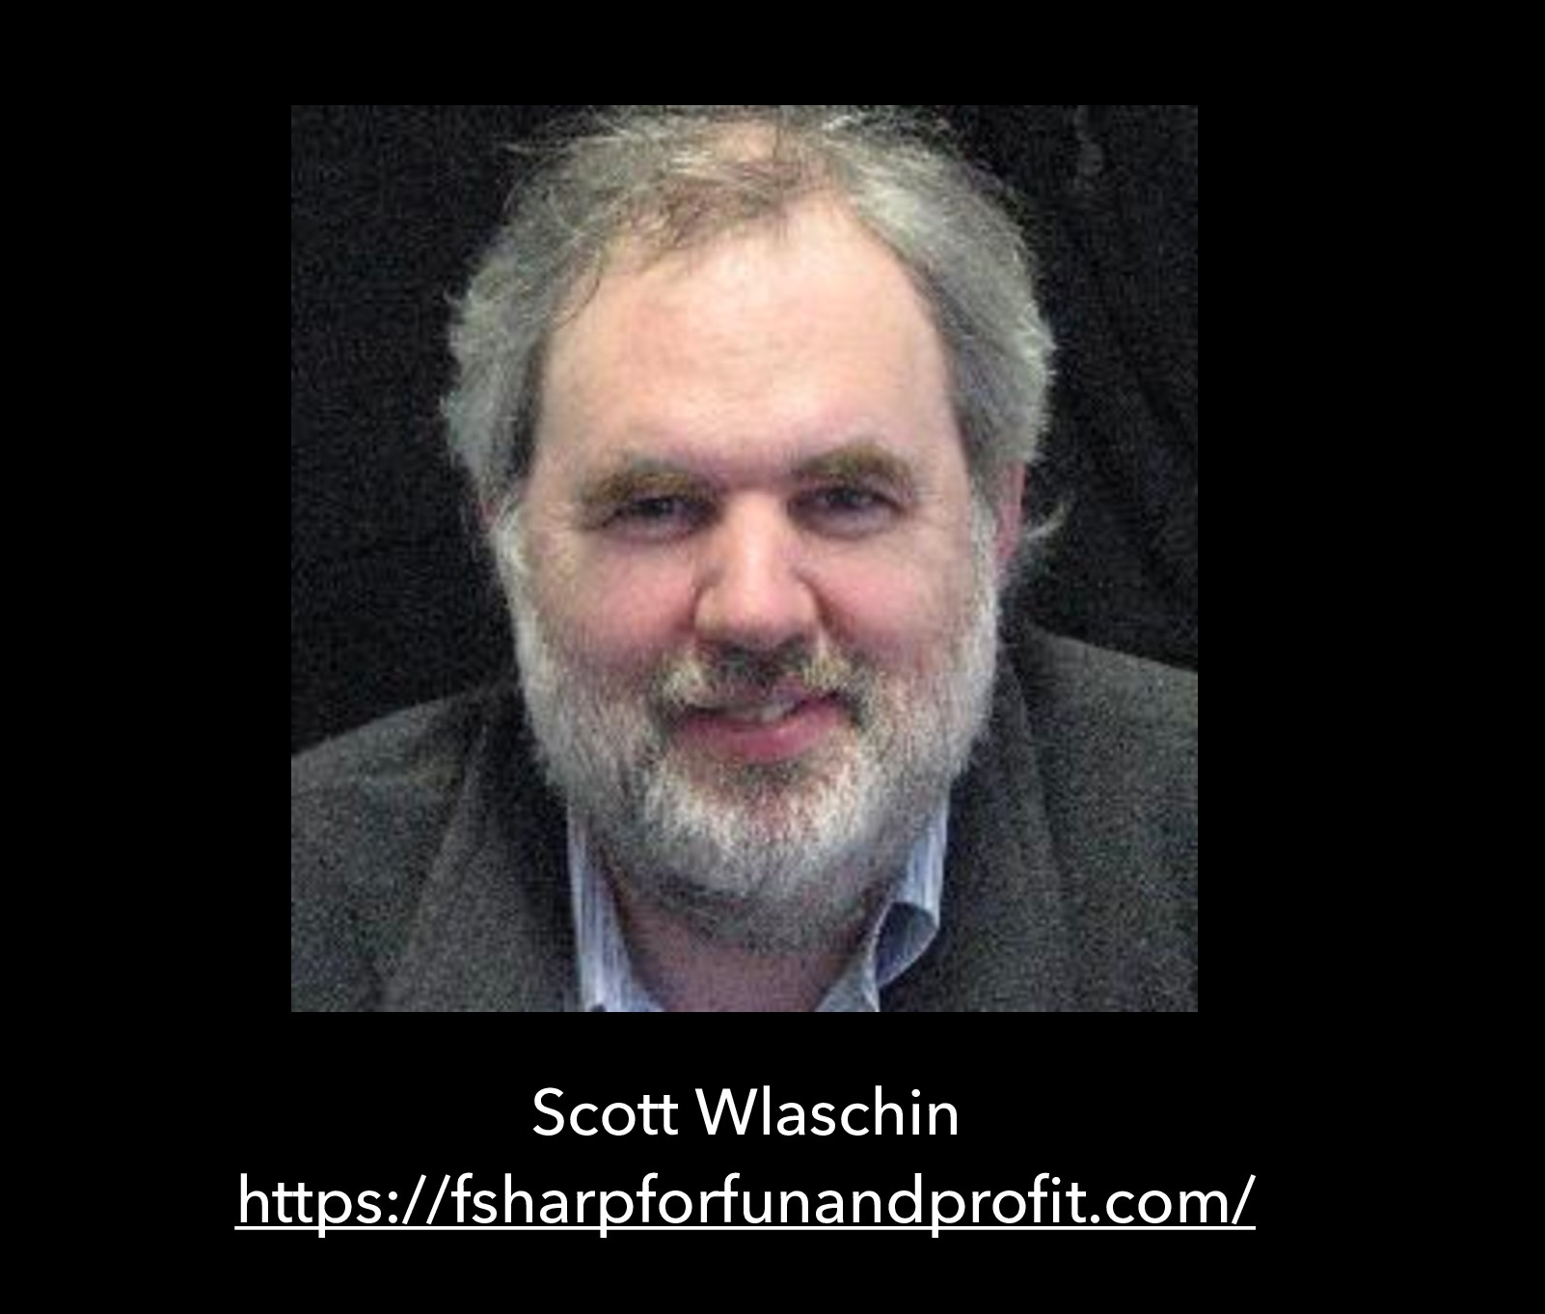
Notes:
Bruno - Scott Wlaschin offers a functional programming model called Railway Oriented Programming (ROP), a functional approach to error handling.
A concrete example to understand: we chain the call to the Validate function with the UpdateDb function and finally the SendMail function, which constitutes the upper rail. The lower rail is composed of the sequence of functions ensuring error handling. The two-track model is the basis for “rail-oriented programming.”

Slide 46
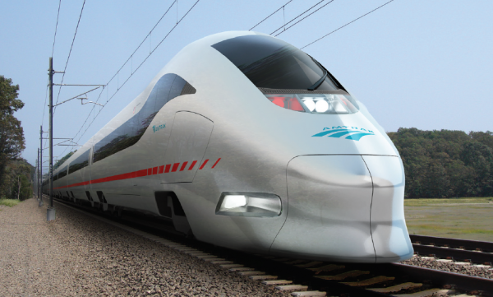
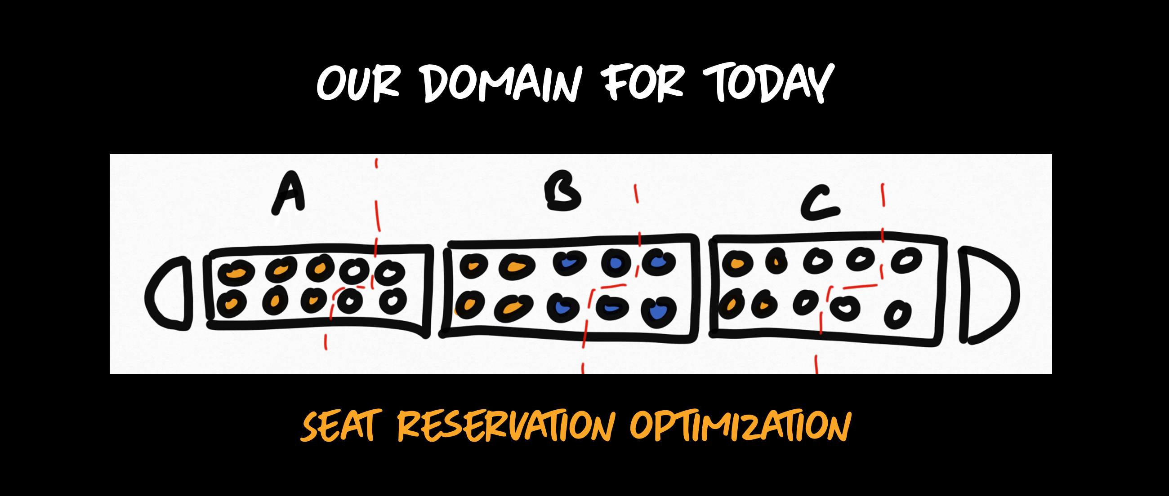
Remember TRAIN-TRAIN?
Notes:
Bruno - With Thomas we spoke, a few years ago around a live coding about the reservation of train tickets.
The problem resided in the management of seat reservations within the cars within a train.

Slide 47
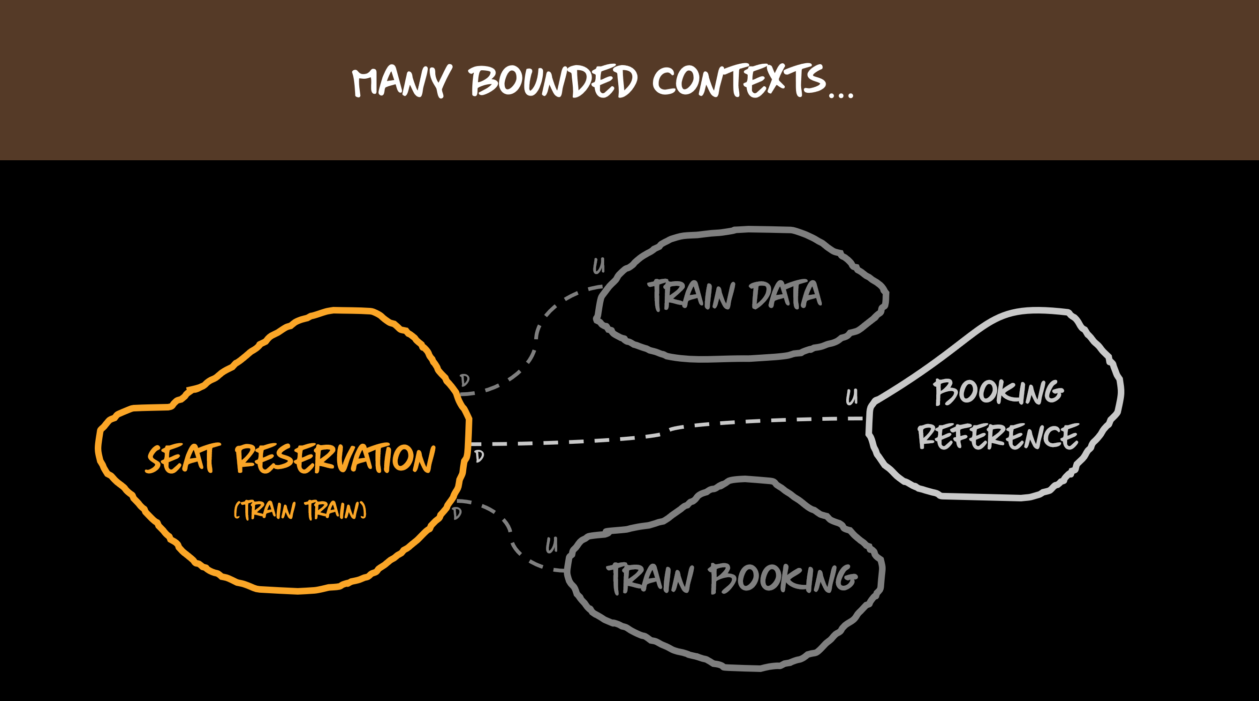
Remember TRAIN-TRAIN?
Notes:
Bruno - Our core business was to manage the business rules around the reservation of seats, represented by the bounded context in yellow. To deal with these rules, we depended on other services. Isn't Thomas?

Slide 48
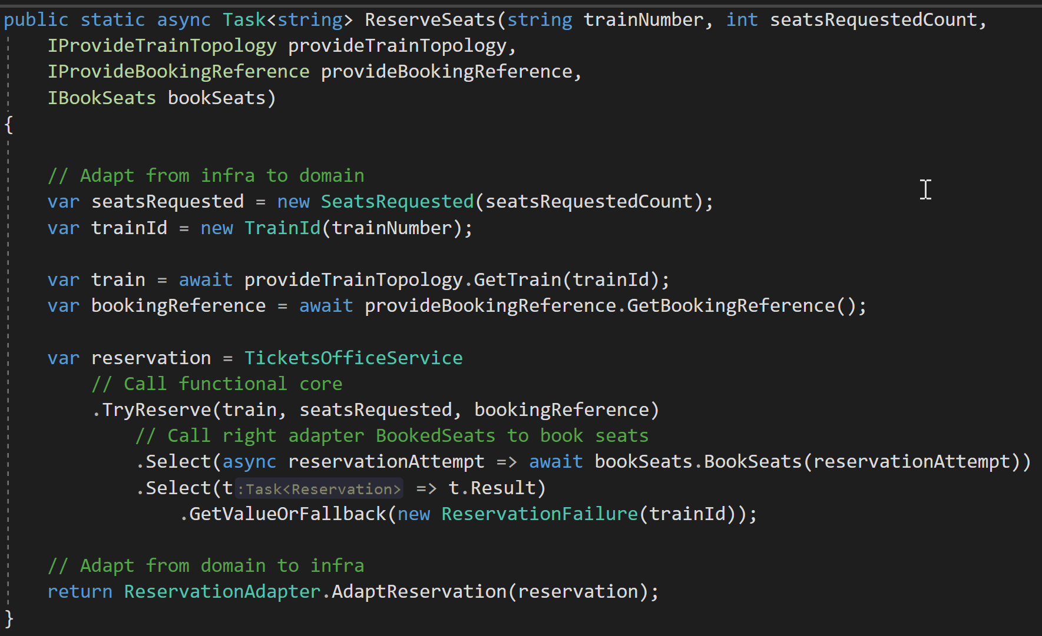
Functional Core – Train reservation
(Imperative shell version)
Notes:
Bruno - Within the imperative shell,

Slide 49
Functional Core – Train reservation
(Imperative shell version)
Call non-pure functions
Notes:
Bruno - we call two impure functions, GetTrain () and GetBookingReference.

Slide 50
Functional Core – Train reservation
(Imperative shell version)
Call non-pure functions
Call pure function - Make decisions
Notes:
Bruno - Then, we move into a case of chaining a pure function (TryReserve) … with an impure function, BookSeats, (e.g., BookSeatsAdapter).

Slide 51
Functional Core – Train reservation
(Imperative shell version)
Call non-pure functions
Call pure function - Make decisions
Acts upon these decisions
Notes:
Bruno - We note a second projection to transform the Microsoft Task model into a simple type of Reservation to avoid propagating the async keyword on the TryReserve method.

Slide 52
To sum-up
Notes:
Thomas

Slide 53
Hexagonal or Functional Core?
Feature | Hexagonal Architecture | Functional Architecture
Separate Infra from Business | Yes | “Yes”
Business Code without side effect
Business Decision are in Business part
Offers good ability to test
Technical concerns never leak from domain
Notes:
- Bruno and Thomas
Try not to stick to just the patterns you know. Dig, see what exists next, but do not choose a model by mode without being able to justify its use in your context. Be able to explain your design choices.
Bruno - seems not to be an option, eg in Haskell, can become so in your APIs in java, C #, Kotlin, etc.
Thomas - Attention, an important point: the Domain slightly leaks the infra layer because the sequencing of the function calls is done from outside the functional kernel
My heuristic is therefore to only use it when there is not too much I / O orchestration to do.
Bruno - I think I am not aligned with you on this point. The functional approach is different. The shell imperative orchestrates the business decisions made by the pure functions.
Bruno: This can only work if your domain is coded in a functional style. Here, our business logic had no state; the state was initially injected during the processing of each request
Comparative matrix.

Slide 54
Hexagonal or Functional Core?
Feature | Hexagonal Architecture | Functional Architecture
Separate Infra from Business | Yes | “Yes”
Business Code without side effect | No* | Yes
Business Decision are in Business part
Offers good ability to test
Technical concerns never leak from domain
Notes:
Try not to stick to just the patterns you know. Dig, see what exists next, but do not choose a model by mode without being able to justify its use in your context. Be able to explain your design choices.
Bruno - seems not to be an option, eg in Haskell, can become so in your APIs in java, C #, Kotlin, etc.
Thomas - Attention, an important point: the Domain slightly leaks the infra layer because the sequencing of the function calls is done from outside the functional kernel
My heuristic is therefore to only use it when there is not too much I / O orchestration to do.
Bruno - I think I am not aligned with you on this point. The functional approach is different. The shell imperative orchestrates the business decisions made by the pure functions.
Bruno: This can only work if your domain is coded in a functional style. Here, our business logic had no state; the state was initially injected during the processing of each request
Comparative matrix.
-----
* By its requirements Functional Architecture is more extreme (code without mutation) and therefore more addressable with functional language.
The hexagonal architecture is more favorable to the OOP

Slide 55
Hexagonal or Functional Core?
Feature | Hexagonal Architecture | Functional Architecture
Separate Infra from Business | Yes | “Yes”
Business Code without side effect | No* | Yes
Business Decision are in Business part | Yes | “Yes”
Offers good ability to test
Technical concerns never leak from domain
Notes:
Try not to stick to just the patterns you know. Dig, see what exists next, but do not choose a model by mode without being able to justify its use in your context. Be able to explain your design choices.
Bruno - seems not to be an option, eg in Haskell, can become so in your APIs in java, C #, Kotlin, etc.
Thomas - Attention, an important point: the Domain slightly leaks the infra layer because the sequencing of the function calls is done from outside the functional kernel
My heuristic is therefore to only use it when there is not too much I / O orchestration to do.
Bruno - I think I am not aligned with you on this point. The functional approach is different. The shell imperative orchestrates the business decisions made by the pure functions.
Bruno: This can only work if your domain is coded in a functional style. Here, our business logic had no state; the state was initially injected during the processing of each request
Comparative matrix.

Slide 56
Hexagonal or Functional Core?
Feature | Hexagonal Architecture | Functional Architecture
Separate Infra from Business | Yes | “Yes”
Business Code without side effect | No* | Yes
Business Decision are in Business part | Yes | “Yes”
Offers good ability to test | Yes | Yes
Technical concerns never leak from domain
Notes:
Try not to stick to just the patterns you know. Dig, see what exists next, but do not choose a model by mode without being able to justify its use in your context. Be able to explain your design choices.
Bruno - seems not to be an option, eg in Haskell, can become so in your APIs in java, C #, Kotlin, etc.
Thomas - Attention, an important point: the Domain slightly leaks the infra layer because the sequencing of the function calls is done from outside the functional kernel
My heuristic is therefore to only use it when there is not too much I / O orchestration to do.
Bruno - I think I am not aligned with you on this point. The functional approach is different. The shell imperative orchestrates the business decisions made by the pure functions.
Bruno: This can only work if your domain is coded in a functional style. Here, our business logic had no state; the state was initially injected during the processing of each request
Comparative matrix.

Slide 57
Hexagonal or Functional Core?
Feature | Hexagonal Architecture | Functional Architecture
Separate Infra from Business | Yes | “Yes”
Business Code without side effect | No* | Yes
Business Decision are in Business part | Yes | “Yes”
Offers good ability to test | Yes | Yes
Technical concerns never leak from domain | No | Yes
Notes:
Try not to stick to just the patterns you know. Dig, see what exists next, but do not choose a model by mode without being able to justify its use in your context. Be able to explain your design choices.
Bruno - seems not to be an option, eg in Haskell, can become so in your APIs in java, C #, Kotlin, etc.
Thomas - Attention, an important point: the Domain slightly leaks the infra layer because the sequencing of the function calls is done from outside the functional kernel
My heuristic is therefore to only use it when there is not too much I / O orchestration to do.
Bruno - I think I am not aligned with you on this point. The functional approach is different. The shell imperative orchestrates the business decisions made by the pure functions.
Bruno: This can only work if your domain is coded in a functional style. Here, our business logic had no state; the state was initially injected during the processing of each request
Comparative matrix.

Slide 58
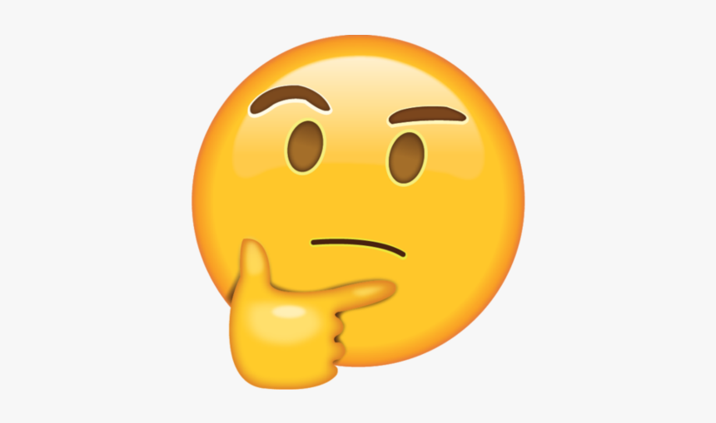
BTW…
Feature | Hexagonal Architecture | Functional Architecture
Separate Infra from Business | Yes | “Yes”
Business Code without side effect | No* | Yes
Business Decision are in Business part | Yes | “Yes”
Offers good ability to test | Yes | Yes
Technical concerns never leak from domain | No | Yes
Does it make sense to compare them?!?
Notes:
But by the way…
(long silence)
Does it make sense to compare those 2 patterns?

Slide 59
BTW…
Feature | Hexagonal Architecture | Functional Architecture
Separate Infra from Business | Yes | “Yes”
Business Code without side effect | No* | Yes
Business Decision are in Business part | Yes | “Yes”
Offers good ability to test | Yes | Yes
Technical concerns never leak from domain | No | Yes
Does it make sense to compare celery and chocolate?!?
Notes:
Does it make sense to compare celery and chocolate? ;-P

Slide 60
Feature | Hexagonal Architecture | Functional Architecture
Separate Infra from Business | Yes | “Yes”
Business Code without side effect | No* | Yes
Business Decision are in Business part | Yes | “Yes”
Offers good ability to test | Yes | Yes
Technical concerns never leak from domain | No | Yes
Does it make sense to compare 2 options related to 2 different paradigms?
Notes:
Does it make sense to compare 2 options that are related to 2 completely different paradigms?
(long silence)
Thomas – I don’t think so. Neither do Bruno.
One can observe and learn. But the adoption of one or another will stand with your context (as always). Your team is using Haskell as the language: of course you will use the functional style architecture with I/Os outside your pure functions. Your team is full of juniors coding in Java or C#... It may be more complicated to have pure functions : relying on Value types, closure of operations etc. It’s doable but… more complex.
So…. There is no silver bullet. As always… And that’s good actually.

Slide 61
OK...
Notes:
Faire une pause de 5 sec.
Bruno – Do you want to switch to your screen for the end of the talk?
Thomas- Yes. Let’s do that (et on switch de share screen)

Slide 62
Last but not least…
”beyond” Hexagonal architecture?!?
Notes:
Thomas- Yes. The title of this talk is Beyond Hexagonal Architecture.
So yes, we can use Functional Core in some occasions to replace Hexagonal Architecture with it.
But we can also talking about Hexagonal Architecture in itself…

Slide 63
we have a question for YOU
Notes:
Because we have a question for you in the audience…

Slide 64
Hexagonal or not hexagonal?
Notes:
The question is… Does the following diagram illustrate an Hexagonal Architecture?

Slide 65
Hexagonal or not hexagonal?
-Yes-
An Adapter can be an ACL
I may not want my domain to be polluted by upstream organizational changes
Notes:
First answer: YES. Because…

Slide 66
Hexagonal or not hexagonal?
-Yes-
An Adapter can be an ACL
I may not want my domain to be polluted by upstream organizational changes
-NO-
I want to stick to Alistair original motivations (i.e. technological) ⬄ 1 port-adapter per technology
Notes:
Second answer: NO….
We will let you think about it for one minute.
Thomas – Kenny: can you please start the poll so that the audience can answer to the question?

Slide 67
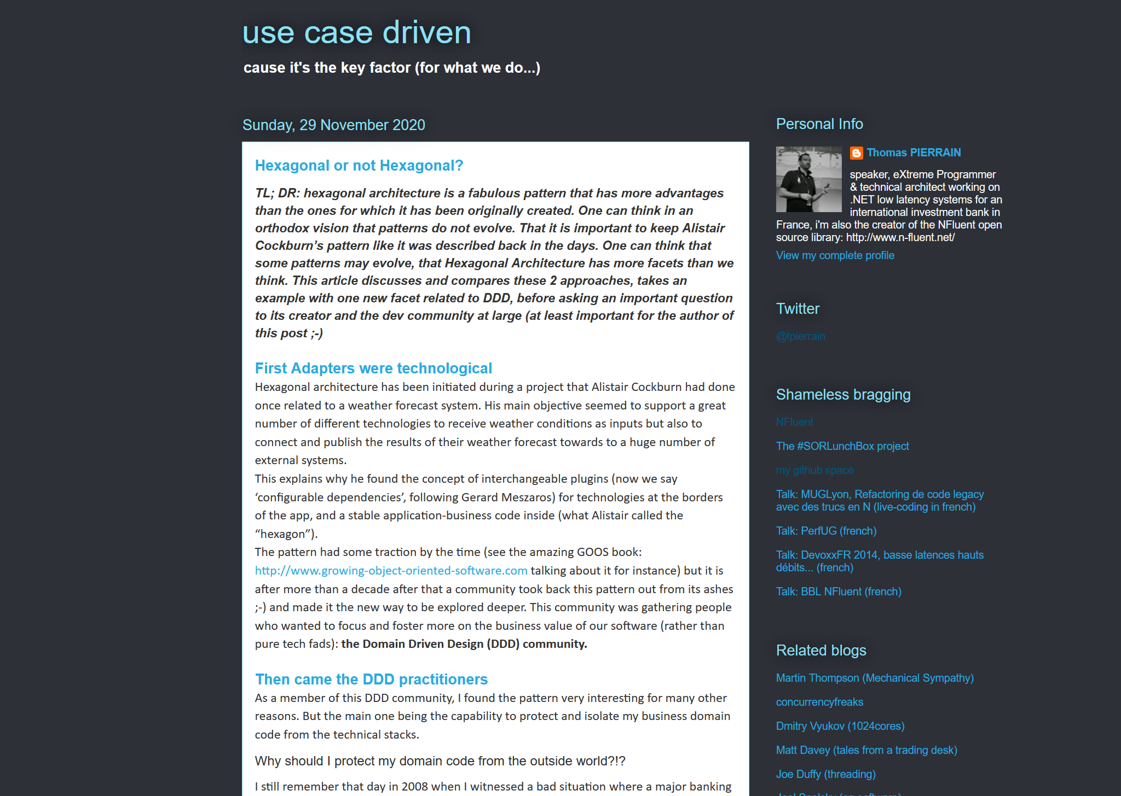
Hexagonal or not hexagonal?
-Yes-
It’s a multi-facets pattern!
The technological facet
The testability facet
The tactical DDD facet
The simplicity facet
The quick feedback facet
The late architectural decisions facet
The strategic DDD facet
Notes:
Thomas – Following some discussion on twitter a couple of months ago, I wrote an article saying : YES
Yes, for me Hexagonal Architecture has became an Umbrella term nowadays. Especially in the Domain Driven Community
The fuzziness of Alistair’s original article has something in common with Eric Evan's Blue Book.
It’s so conducive to various interpretations that it ages really well.
It’s a multi-facet pattern.
One may have the same need as Alistair and pick it for its technological plugins capabilities
One may pick it for testing, like Steve Freeman & Nat Pryce in their tremendous GOOS book
Another one may -like me- pick it because it allows us to protect our domain code from the infrastructure one. What I called the Tactical DDD facet
Another one may –again like me- pick it because it allows us not to have too many layers. Only 2: infra / domain. What I called the Simplicity facet
Another one may pick it in order to have quick feedback; focusing on the domain first and seeing some decision lately, once we know what we need as data store, data base & stuffs
Another one may – like me or Julien Topçu- pick it because it allows us to put some strategic DDD and ACLs in right-side adapters. What I called the Strategic DDD facet.
See?!? This pattern may be chosen for so many reasons, providing so many tradeoffs and options.. That I really think one should continue to use it BEYOND the pure and original technological facet.
And if the community do not agree. If one think it should just remain a way of switching technologies with plug-ins like originally stated by Alistair. We will need to ask ourselves how to name all these facets that –WE- the DDD community used to play with since so many years

Slide 68
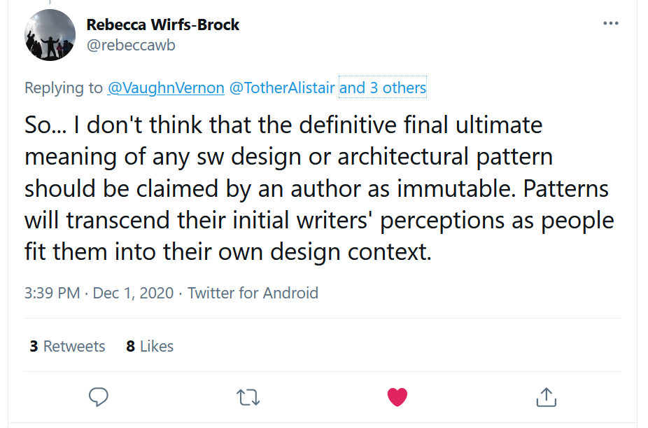
Hexagonal or not hexagonal?
Notes:
And as stated by Rebecca Wirfs-Brock during our discussions on twitter with Alistair, Vaughn, Juan Garrido Paz and Matt Wynne:
“Patterns will transcend their initial writer’s perceptions as people fit them into their own design context”
Tweet:
https://twitter.com/rebeccawb/status/1333782730732048387?s=20

Slide 69
And if we finally vote no…
The DDD community will have to find new name(s) for all our usages
The technological facet
The testability facet
The tactical DDD facet
The simplicity facet
The quick feedback facet
The late architectural decisions facet
The strategic DDD facet
Notes:
Thomas - And if we finally vote no…
The DDD community will have to find new name(s) for all our usages
But I’m not worried… because this is something the DDD community is kind of expert in: searching the best possible names for thing ;-)

Slide 70
Thank you!
Notes:
And it’s time for you to thank you for your patience.
And probably the time to have some conversations…with those that are still here and want to ask questions or to discuss.
Kenny, are there questions?
Meanwhile, we will push a list of resource related to our session.

Slide 71
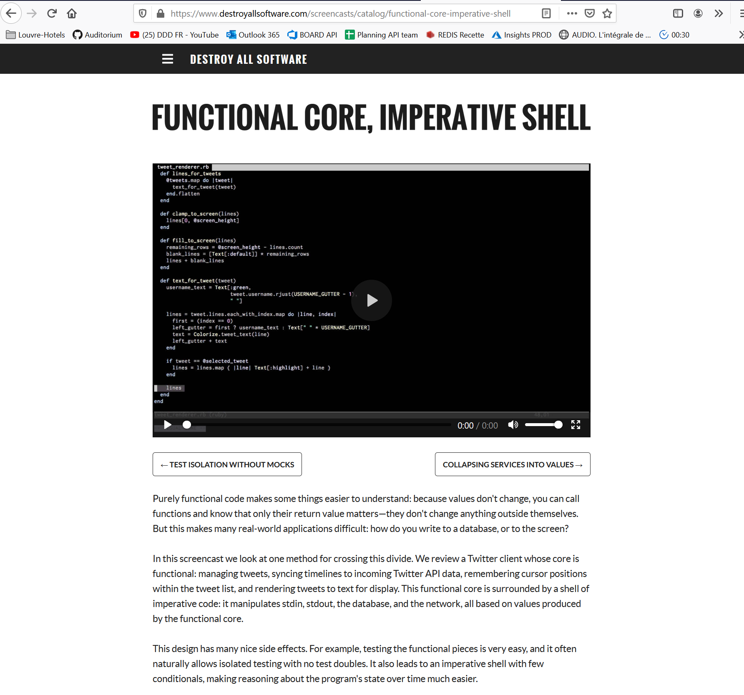
Some references
Functional Core, Imperative Shell – Gary Bernhardt
https://www.destroyallsoftware.com/screencasts/catalog/functional-core-imperative-shell
Functional Core - Jérémie Chassaing
https://thinkbeforecoding.com/post/2018/01/25/functional-core
The Maybe functor - Mark Seemann
https://blog.ploeh.dk/2018/03/26/the-maybe-functor/
Hexagonal or not hexagonal? – Thomas PIERRAIN
http://tpierrain.blogspot.com/2020/11/hexagonal-or-not-hexagonal.html

